Slide 1
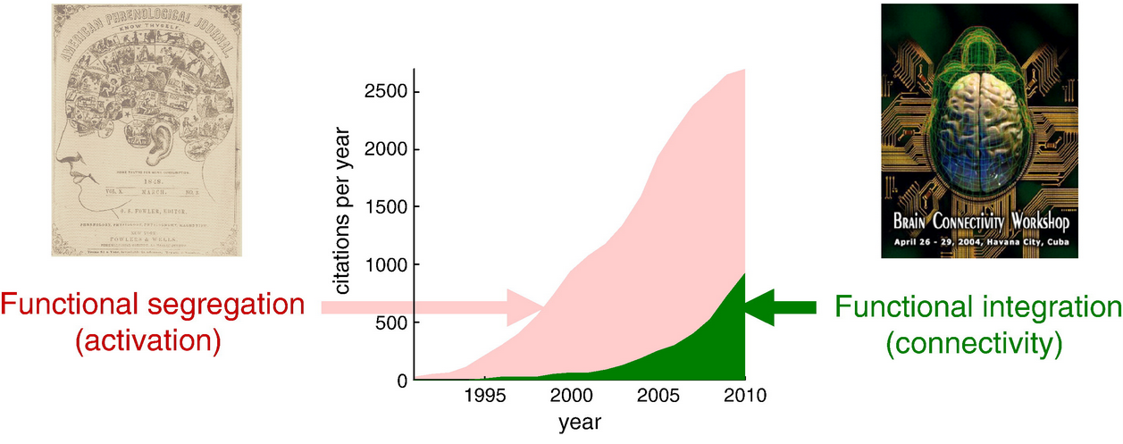
No Brain Region Works in Isolation
Goal 1: Review seed-based functional connectivity approach.
Goal 2: Introduce alternative approach involving independent component analysis and dual regression.
Fox & Friston, (2012). NeuroImage.

Slide 2
Goal 1: Review seed-based functional connectivity approach.

Slide 3
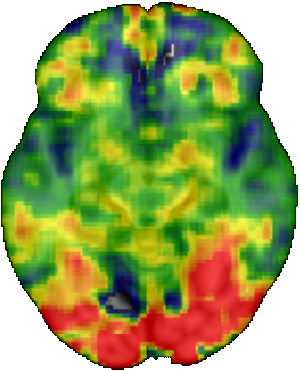
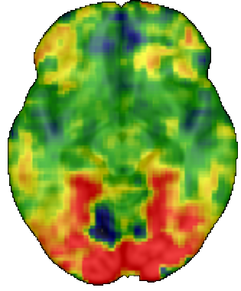
Analyzing Neuroimaging Data: The General Linear Model
Most neuroimaging studies employ the general linear model (GLM) to evaluate the relationship (β) between each voxel (Y) and a hypothesized model (X).
Y = Xβ + ε
Faces
(β image)
Houses
(β image)
Voxel_{(x,y,z)}
Faces
Houses
Faces
Houses
-5
0
5
β value

Slide 4
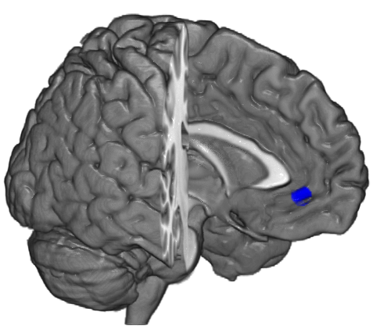
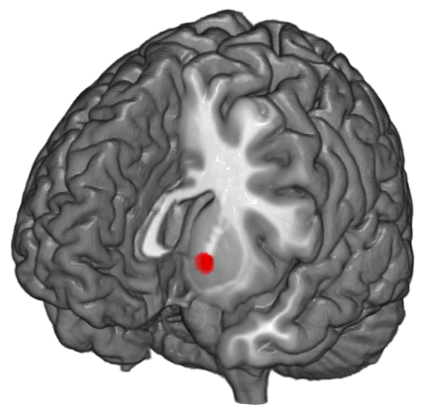
Functional Connectivity Analysis
If two areas exhibit functional connectivity with each other, they will have similar activation across time.
Seed Region
Target Region(s)

Slide 5
Functional Connectivity Analysis
If two areas exhibit functional connectivity with each other, they will have similar activation across time.
Seed Region
Target Region(s)

Slide 6
Functional Connectivity Analysis
Psychophysiological Interaction (PPI) analyses examine functional connectivity that is task dependent.
If two areas exhibit functional connectivity with each other, they will have similar activation across time.
Seed Region
Target Region(s)
Psychological Variable:
High > Low Attractiveness
High
Low
Notes:
Emphasize that this is just a schematic. Real data is next.

Slide 7
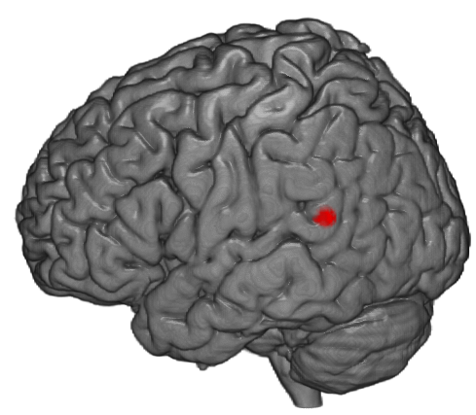
Functional Connectivity Analysis
Psychophysiological Interaction (PPI) analyses examine functional connectivity that is task dependent.
Seed Region
Target Region(s)
Psychological Variable:
High > Low Attractiveness
High
Low
Notes:
Emphasize that this is just a schematic. Real data is next.

Slide 8
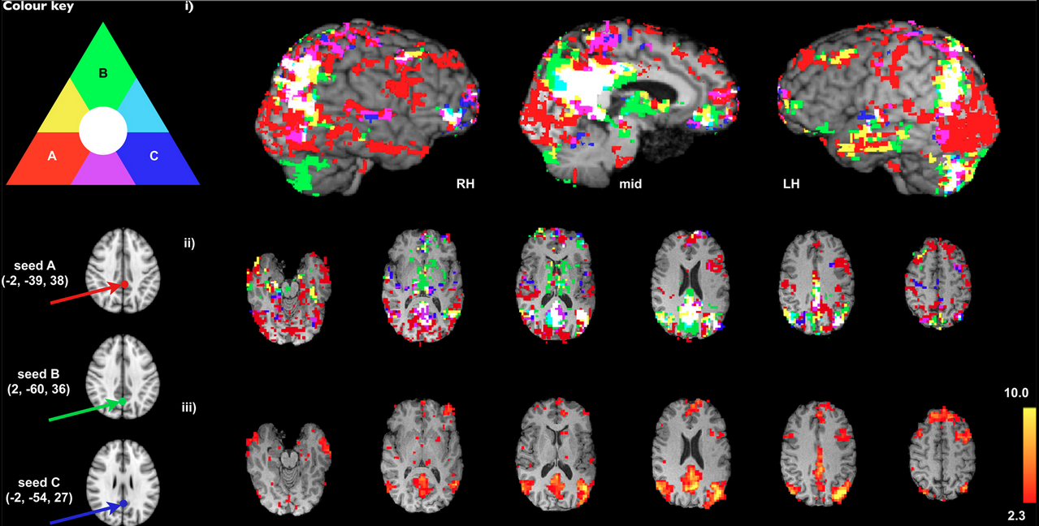
But How Do We Choose an Accurate Seed Region?
Seed-based results depend critically upon seed location.
Can a node of a network be used to represent that network?
Cole et al., 2010, Frontiers in Systems Neuroscience.

Slide 9
Goal 2: Introduce alternative approach involving independent component analysis and dual regression.

Slide 10
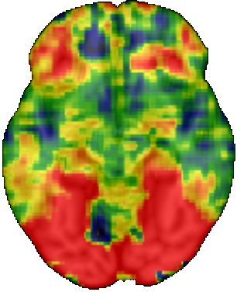
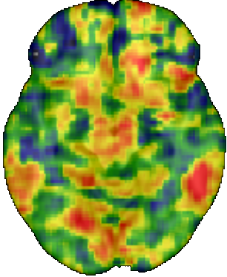
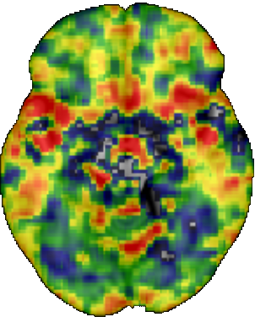
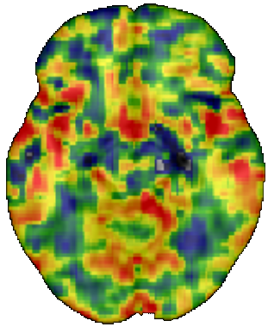
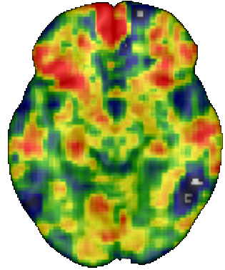
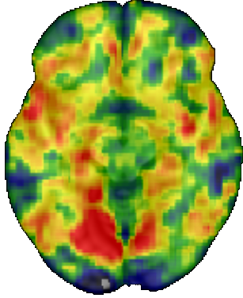
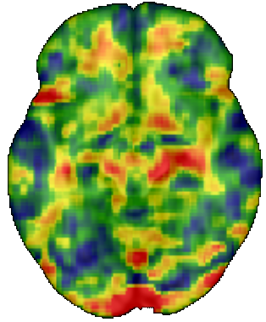
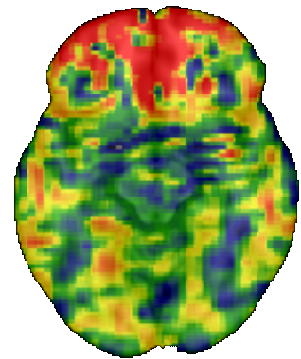
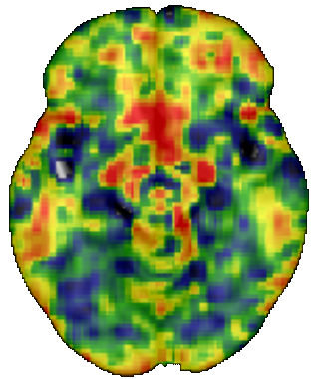
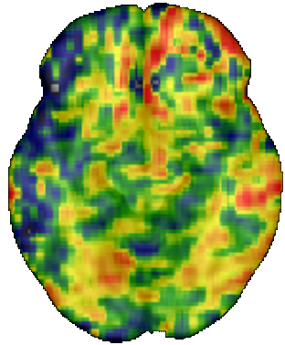
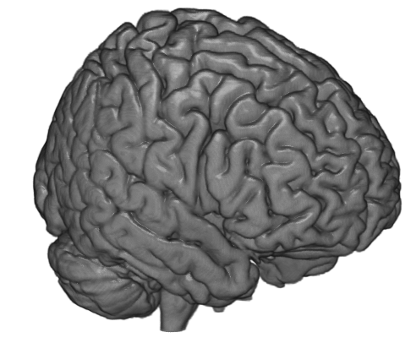
Moving Beyond the GLM with Independent Component Analysis
Independent component analysis (ICA) decomposes data (X) into a mixing matrix (A) and spatially independent source signals (s).
X = Αs + η
Source Signals independent spatial maps
(think “beta images”)
All Voxels
Mixing Matrix
(think “design matrix”)
Time

Slide 11
Why Bother with ICA?
GLM is confirmatory
“How well does the data fit my model?”
Results depend on the model
ICA is exploratory
“Is there anything interesting in my data?”
Can give unexpected results
Multivariate approach offers at least two advantages:
Investigating large-scale networks
(e.g., Smith et al., 2014, NeuroImage)
Dissociating overlapping response patterns
(e.g., Utevsky, Smith, Huettel, 2014, Journal of Neuroscience)

Slide 12
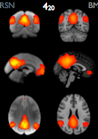
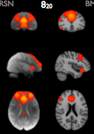
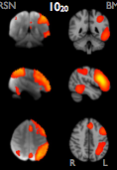
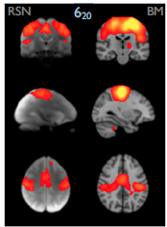
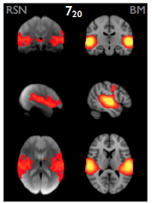
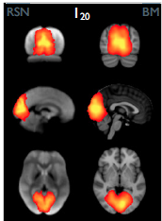
Distributed Networks
Independent Component Analysis (ICA) is a model-free approach for estimating networks.
Default-Mode
Executive-Control
Fronto-Parietal
Connectivity with these networks can be estimated using dual regression
(Filippini et al., 2009, PNAS).
Sensorimotor
Auditory
Visual
Smith et al. (2009). PNAS.

Slide 13

Not an iceberg
Not a Neural Network
Iceberg
Neural Network
Dual Regression
Step 1: For each network, estimates subject-specific temporal characteristics.
Step 2: For each voxel, estimates subject-specific functional connectivity with each network.

Slide 14
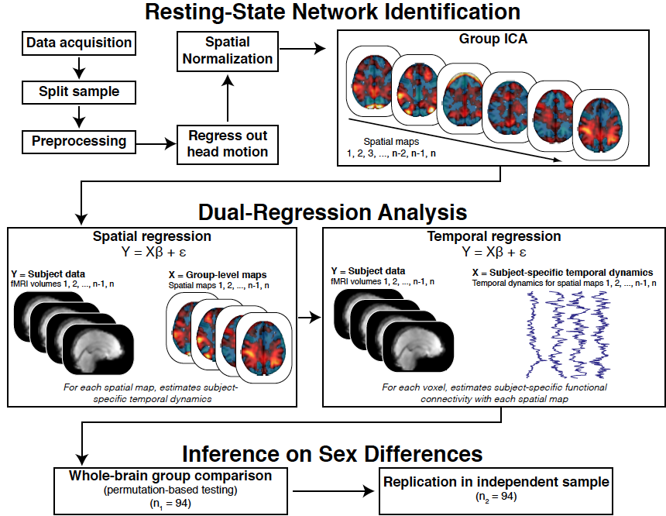
Quantifying Individual Differences in Connectivity with Networks
Smith et al. (2014), NeuroImage.

Slide 15

Comparing Dual-Regression Analysis and Seed-Based Analysis
Auditory Network Identified with ICA
ROC Analysis using Target Region
Seed: Left Heschl’s Gyrus
Target: Right Heschl’s Gyrus
Dual-regression analysis is better at detecting individual differences in connectivity with networks.
Smith et al. (2014), NeuroImage.

